Slide 1


FULL STACK WEB DEVELOPMENT WITH DJANGO
Lecture 31

Slide 2

Today’s Agenda
Developing Our Django App
Customizing Error Messages
Styling Error Messages
Adding More Styles Using CSS

Slide 3
Customizing Error Messages
Built-in Form Field Validations in Django Forms are the default validations that come predefined to all fields.
Also they have predefined/default error messages to be shown in case of errors.

Slide 4
Customizing Error Messages
But we can change these error messages by passing a dictionary to the error_messages keyword argument to the Form field constructor
Syntax:
field_name = forms.Field(error_messages = {"key": "message"})

Slide 5
Creating Form Class
from django import forms
class RegisterForm(forms.Form):
name = forms.CharField(error_messages={'required':'Please enter your name!'})
email=forms.EmailField(error_messages={'invalid':'Not a valid email!'})

Slide 6
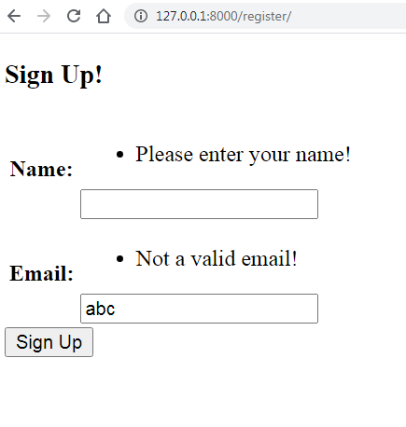
Output

Slide 7
Keys For Error Messages
required
max_length
min_length
max_value
min_value
invalid_choice
invalid
overflow

Slide 8
Styling The Error Messages
When Django produces error messages it creates a <ul> tag containing the <li> tag for the error message.
It also gives this <ul> a class called “errorlist”.
So in our template file we can use CSS codes to style this unordered list using it’s class attribute.

Slide 9
Styling The Error Messages
Moreover Django also creates an attribute called errors in the Form object .
It is of type ErrorDict and contains whole of the error messages and ul tags

Slide 10
Example
<style>
.errorlist{
list-style-type: none;
margin: 0;
padding:0;
color: crimson;
}
</style>
.
.
<body>
{% if form.errors %}
<p style='color: crimson'>
Please remove the following erros!
</p>
{% endif %}
.
.

Slide 11
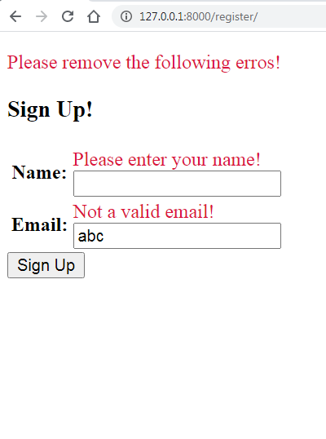
Output

Slide 12
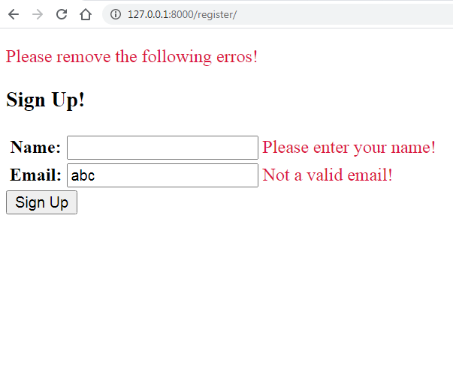
More Styling
Now suppose we want to display each error message on the right of its form field as shown below:

Slide 13
More Styles
For this we will have to render the form manually .
This is done as follows:
Loop over the form object
This will give each element of the form object which is the input field
Each input field has 2 attributes called label_tag and errors which give the text and error text for that field.
Use them to display the form field with label text and error message

Slide 14
The Code
<form action="" method="POST" novalidate>
{% csrf_token %}
<table>
{% for field in form %}
<tr>
<th>{{ field.label_tag}}</th>
<td>{{ field }}</td>
<td>{{ field.errors }}</td>
</tr>
{% endfor %}
</table>
<input type='submit' value='Sign Up' >
</form>

Slide 15
Output

